Slide 1
EV Charging Assistance
GROUP NO. 6
Project Manager 210943120086_Saurabh Phadnis
Member 1 210943120079_Sanket Repale
Member 2 210943120091_Nagesh Shinde
Member 3 210943120057_Mugdha Shinde

Slide 2
Description
EV Charging Station Assistance project enables user to locate nearby EV charging stations.
Also it allows user to book an appointment by considering availability of time slots.
This app helps station managers to register their stations and services to reach maximum customers.
This project is completed by using technologies like Springboot, React and MySQL

Slide 3
Need of project
In current situation customer only get to know about location of nearby charging stations.
Customer needs to stay in queue in order get their EV charged.
Charging stations which are located away from prime areas get affected because customers are unaware about their existence.

Slide 4
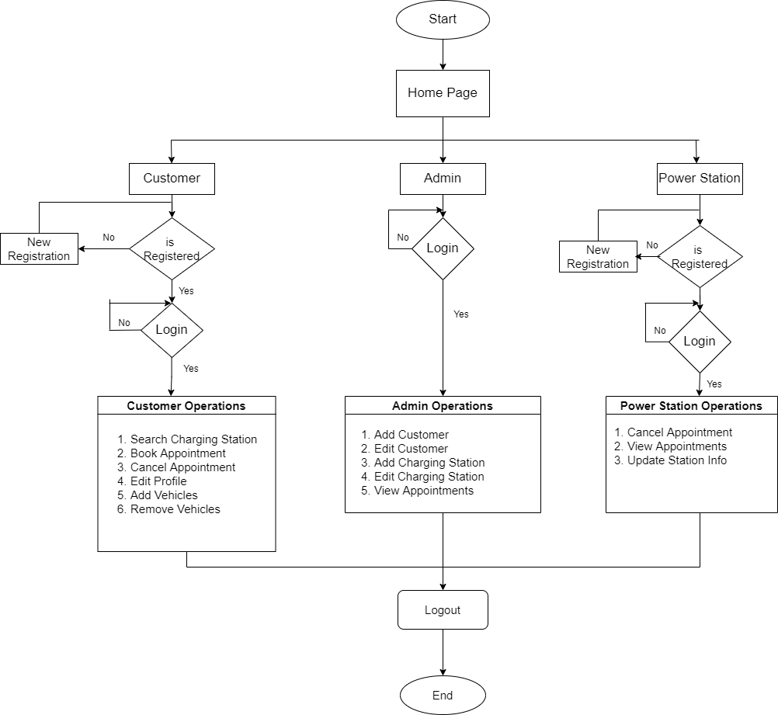
Flowchart

Slide 5
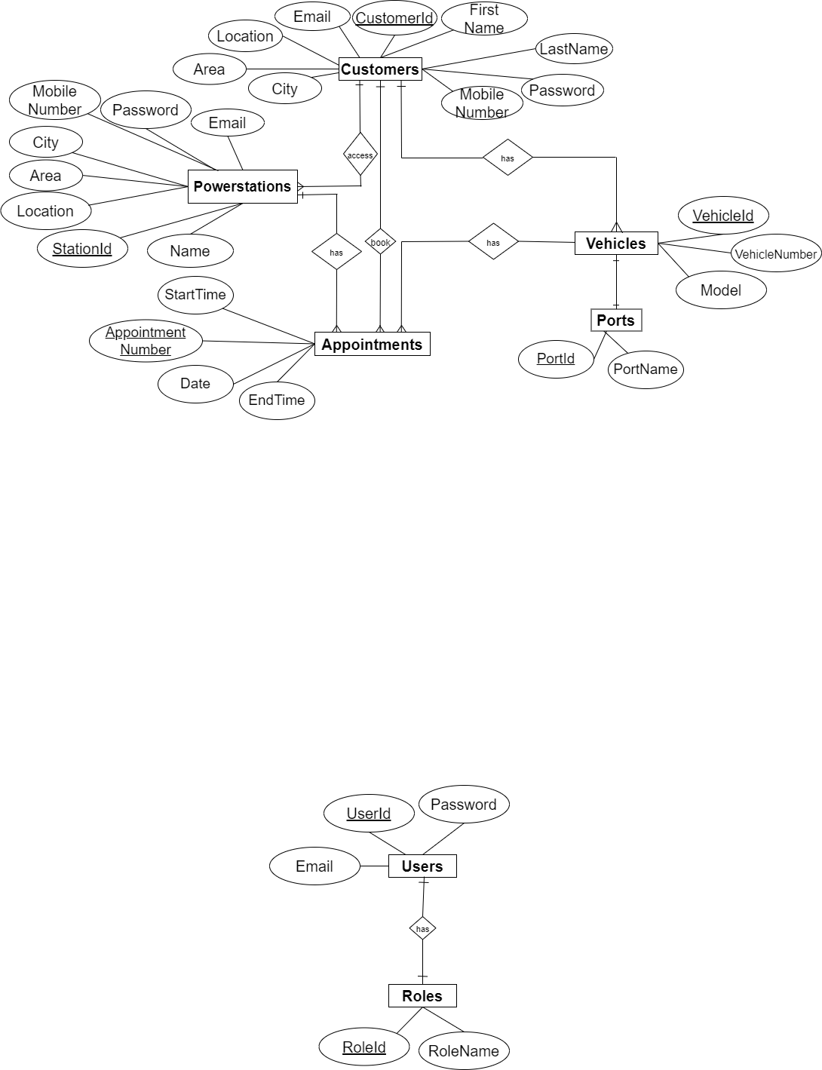
ER Diagram

Slide 6
Future Scope
The payment gateway can be added for user's convenience. For instance, one can integrate to pay with e wallets, UPI, Debit or Credit cards.
After charging electric vehicle, users can give ratings about the charging station.
AI-based chat-bots can respond efficiently to support and answer users’ queries whenever needed.
Regular use of an EV charging app giving users some reward points in the forms of promotional coupons.

Slide 7
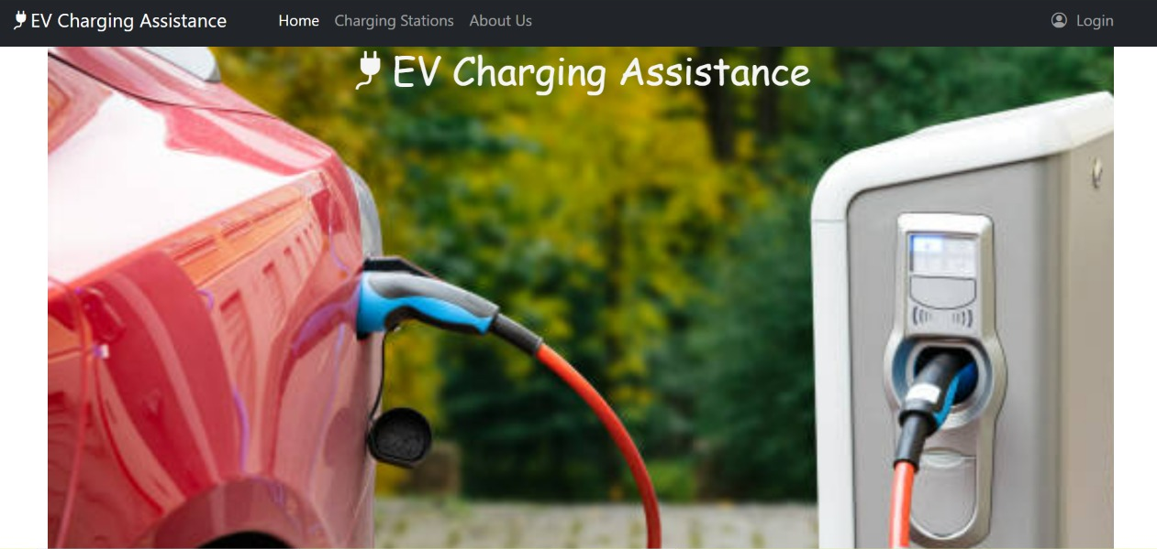
Output of project
Home Page

Slide 8
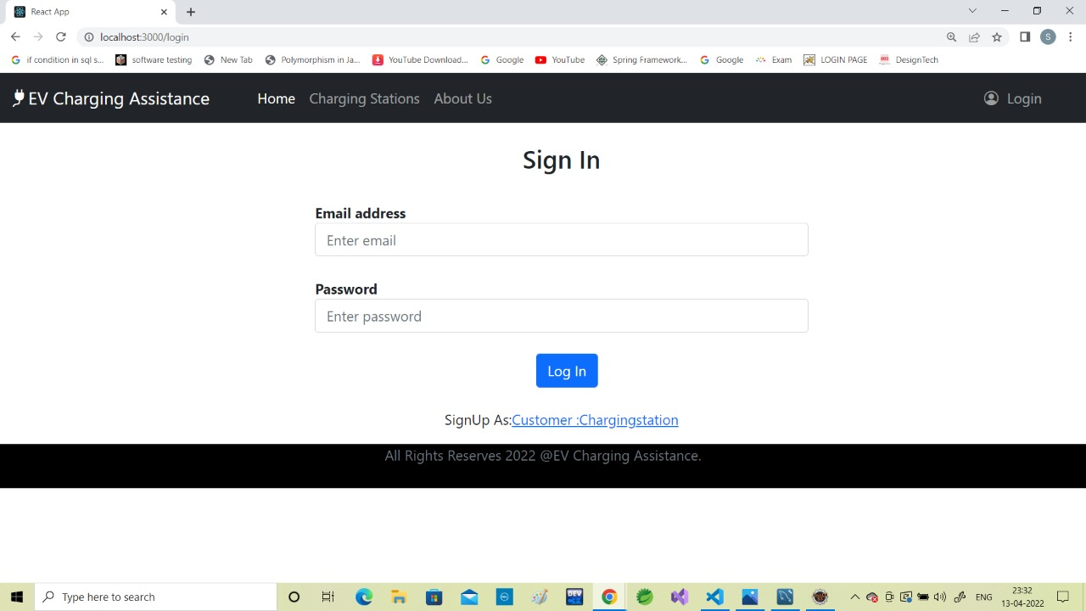
Output of project
Login Page

Slide 9
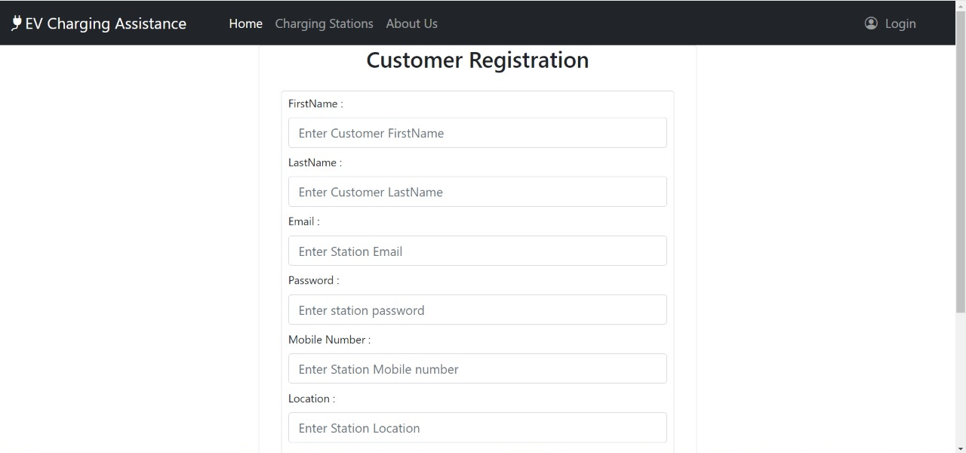
Output of project
Customer Registration Form

Slide 10
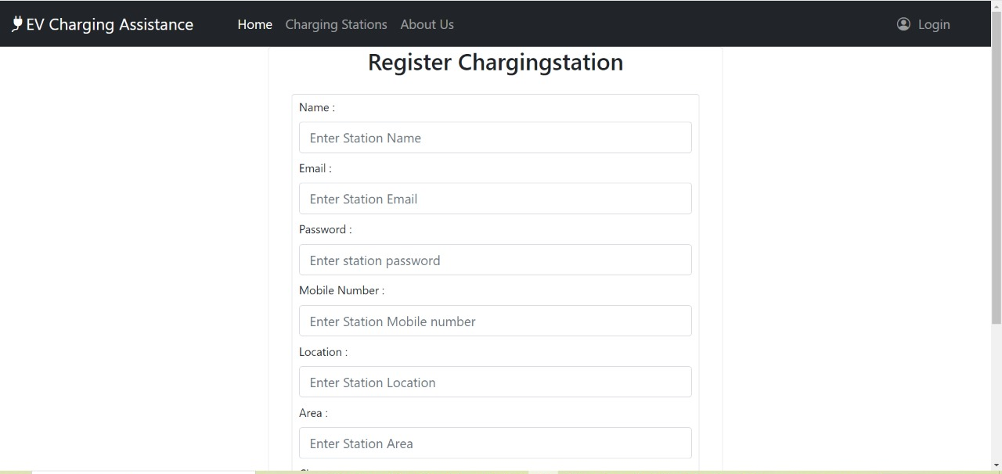
Output of project
Charging Station Registration Form

Slide 11
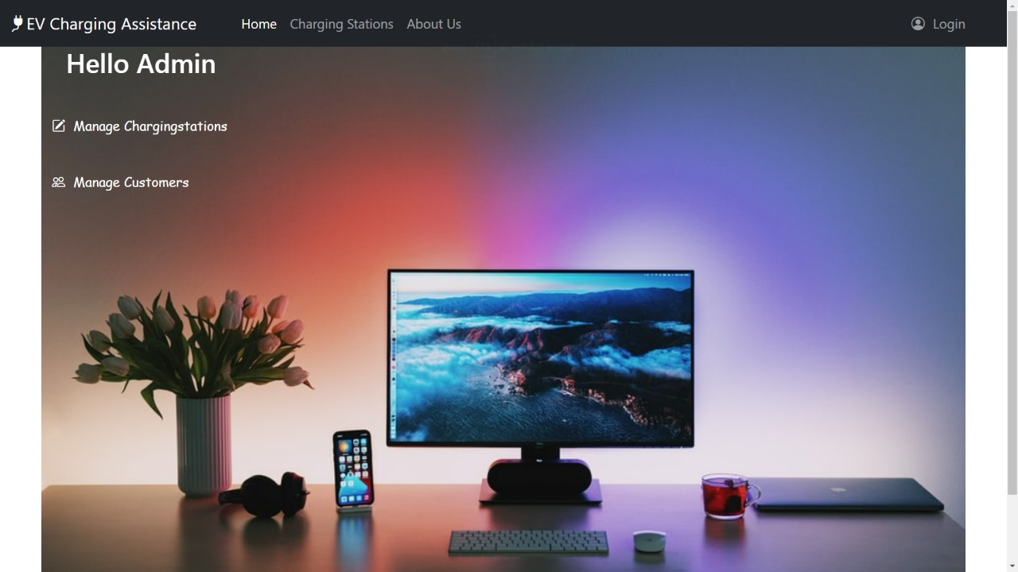
Output of project
Admin Page

Slide 12
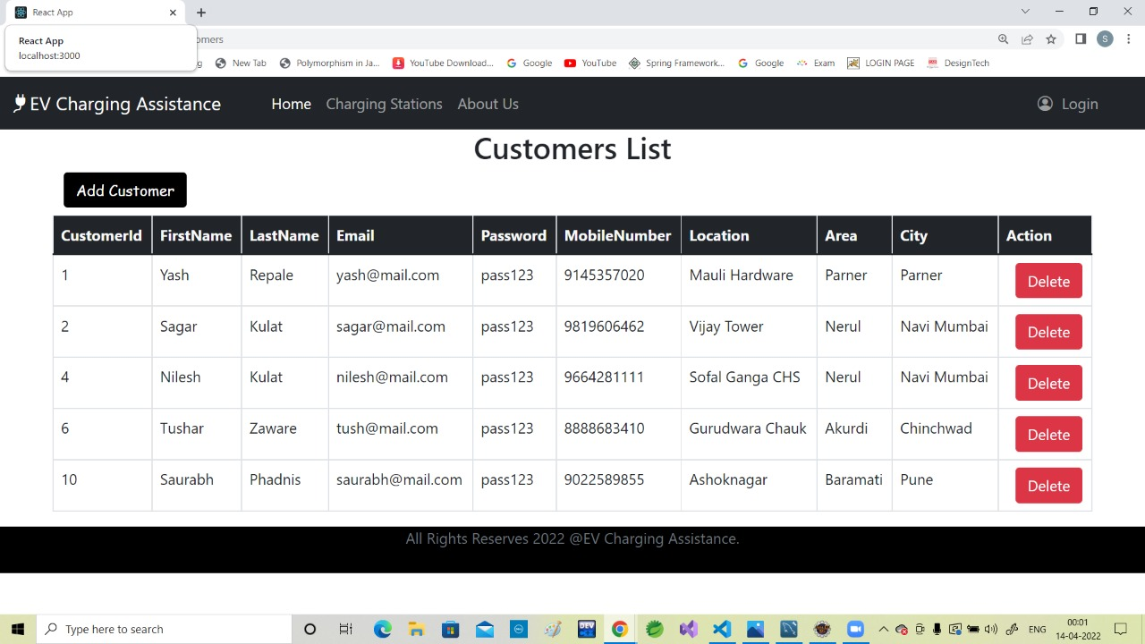
Output of project
Manage Customers Page

Slide 13
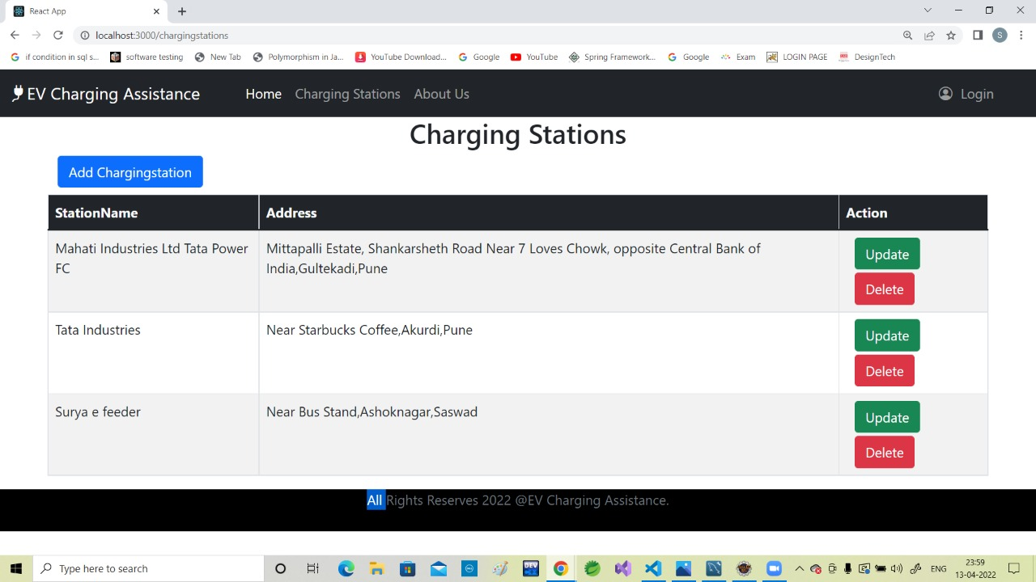
Output of project
Manage Charging Station Page

Slide 14
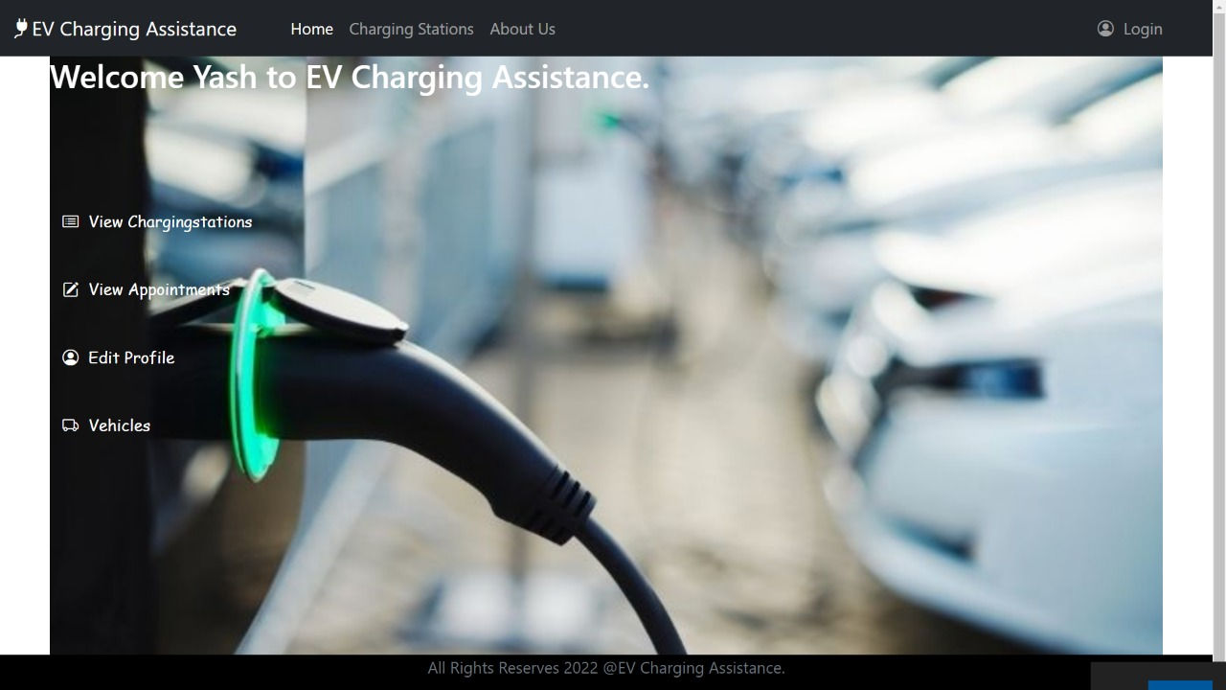
Output of project
Customer Page

Slide 15
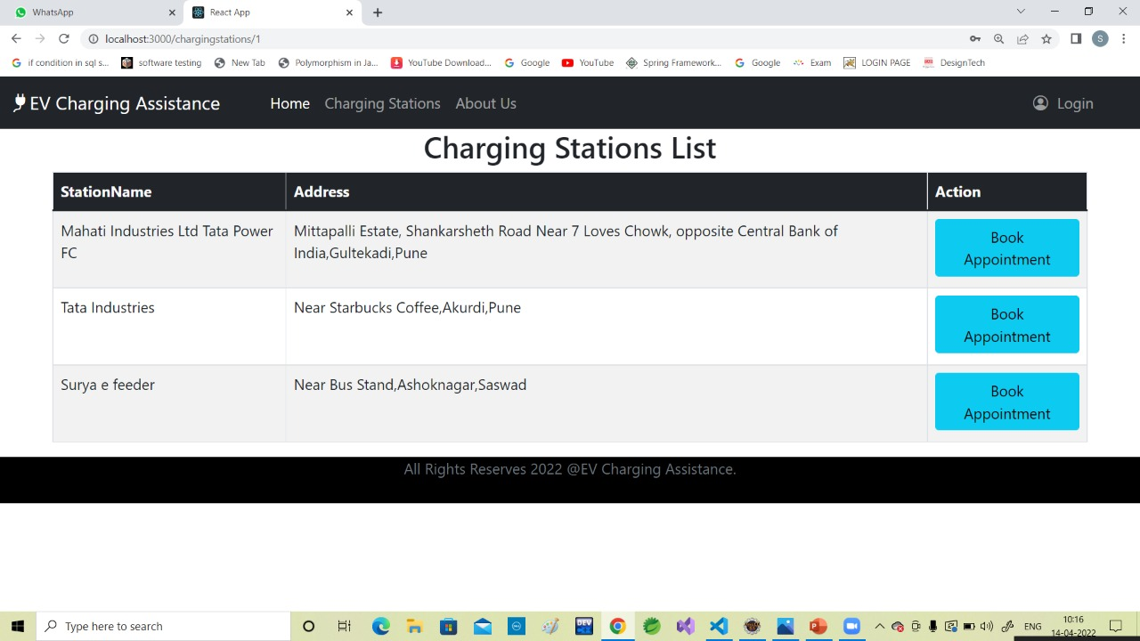
Output of project
List of Charging Stations

Slide 16
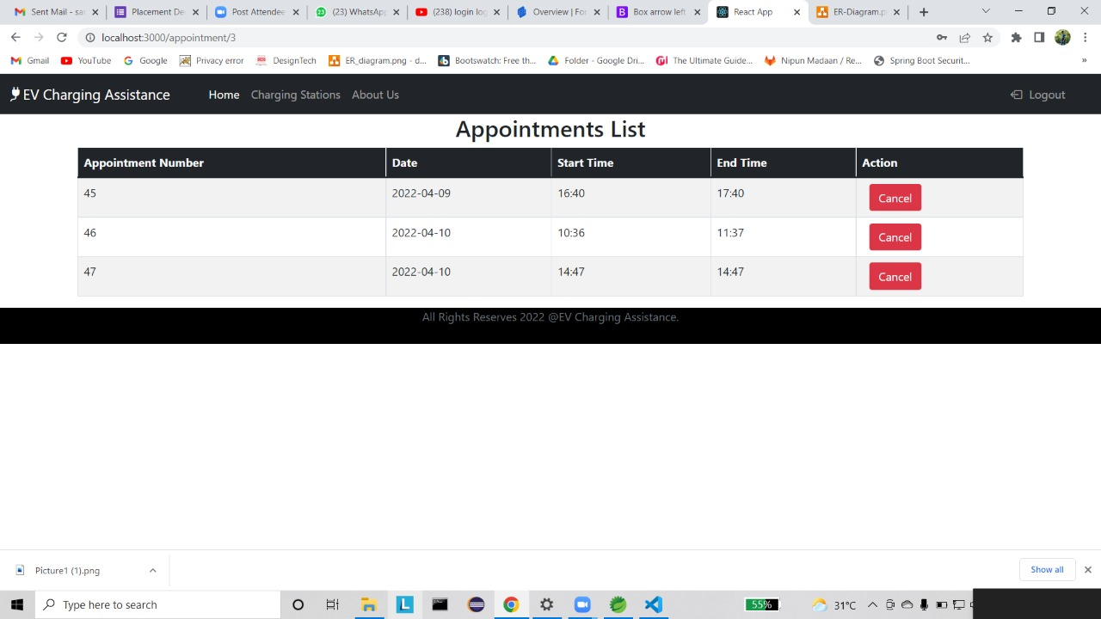
Output of project
List of Appointments Page

Slide 17
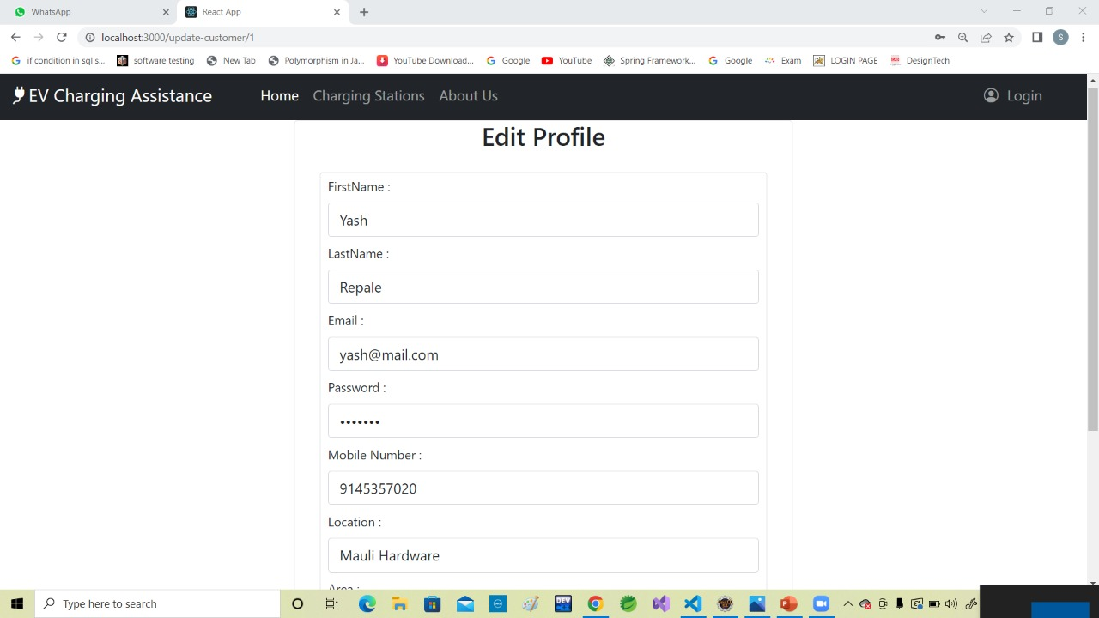
Output of project
Edit Customer Profile Page

Slide 18
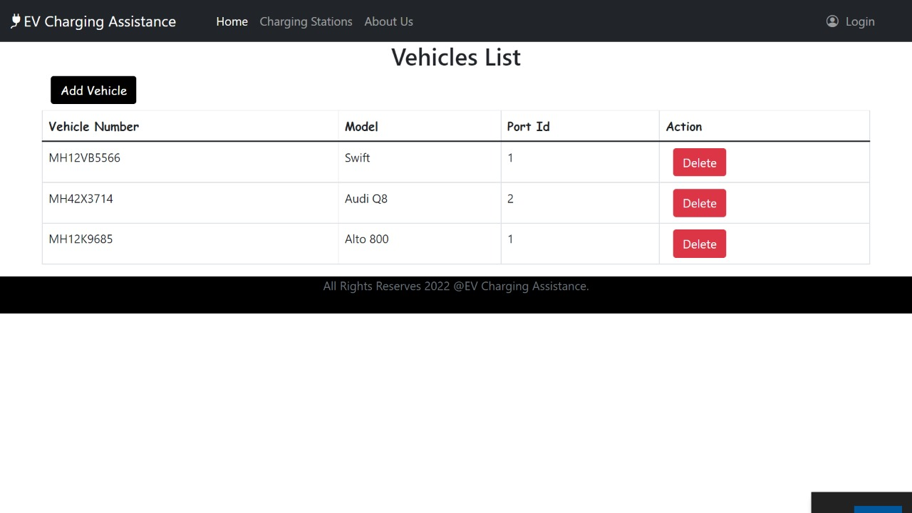
Output of project
Vehicle List Page

Slide 19
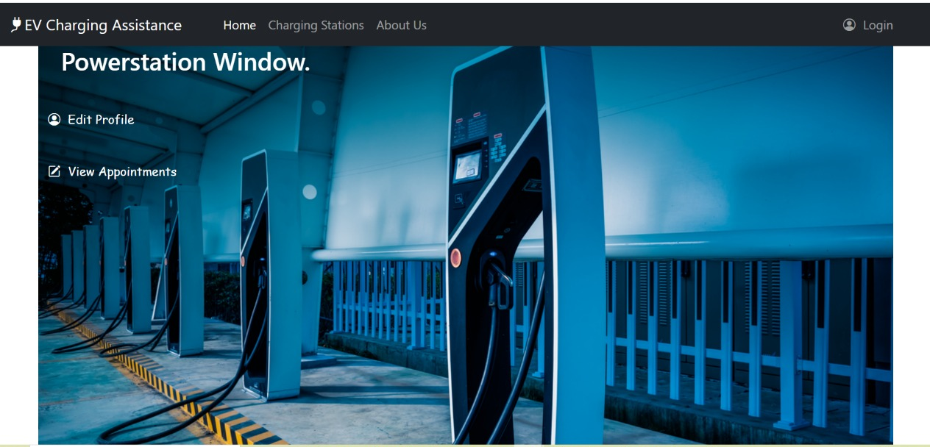
Output of project
Powerstation Page

Slide 20
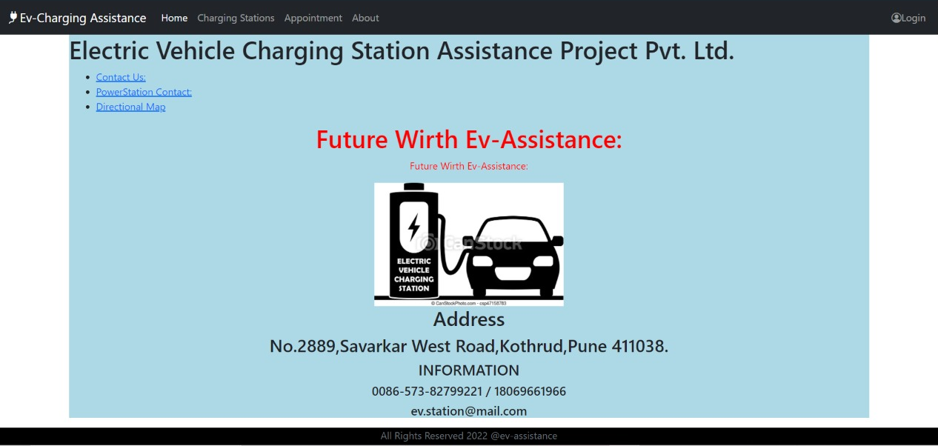
Output of project
About Us Page

Slide 21
Conclusion
With some great features and functionalities, we expect to get many electric vehicles on the market in the future. The rising demand for EVs increases the need for charging stations and charging station assistance apps also. So to create such an app to meet users’ expectations and win the competition, we should look forward to integrate basic functionalities used in this app with user friendly interface and much more features which are discussed within future scope of this documentation.

Slide 22
THANK YOU

